Slide 1
UNCERTAINTY QUANTIFICATION OF AGENT-BASED MODELS WITH APPLICATION TO MALARIA INTERVENTION MODELING
PhD Student: Zenabu Suboi
First Supervisors: Dr. Emilie Pothin
Prof. Dr. Christian Lengeler
Dr. Christian Selinger
Second Supervisor: PD Dr. Amanda Ross

Slide 2
Background training
Education
Current Work Experience
Feb 2024 - Ongoing 01.2019 – 12.2020 08.2017 – 06.2018 | PhD Candidate, Epidemiology – Analytics and Intervention Modeling Group Swiss Tropical & Public Health Institute/ University of Basel, Switzerland Master in Mathematics, Stellenbosch University, South Africa Master in Mathematical Science, AIMS – South Africa
09.2012 – 06.2016 | Bachelor in Statistics, University for Development Studies, Ghana
10.2021 – Date | Assistant Lecturer at Academic City University College, Ghana (On Leave)

Slide 3
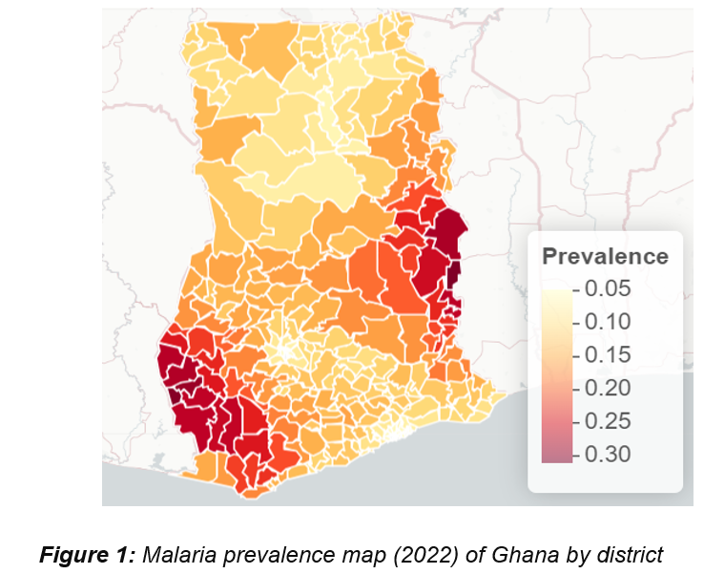
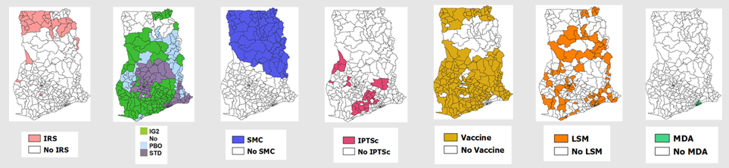
Malaria Prevalence in Ghana is highly heterogeneous
OpenMalaria is used to simulate the impact of interventions for intervention stratification at the sub-national level
Source: MAP, figure by: Sumaiyya Thawer
Source: NMEP, figure by: ZS

Slide 4
Uncertainty in Agent-Based Model outputs stem from different sources
Model uncertainty
Stochastic uncertainty
Parameter uncertainty
Observation uncertainty
Model output
Notes:
In the context of ABMs, there are several acknowledged sources from which uncertainty can originate and then propagate through the model.
there are often uncertainties in the real-world process that an ABM is designed to simulate. This can be because any observations taken are inaccurate or because the system is stochastic and, therefore, multiple observations lead to different results

Slide 5
EIR is not the only source of Parameter Uncertainty in Intervention Modeling
EIR
This PhD seeks to quantify and propagate the uncertainty from various parameters in the OpenMalaria Ghana model, beyond just the entomological inoculation rate (EIR) and to determine the impact of these uncertainties on simulating the effect of malaria interventions at the sub-national level
Parameter uncertainty
ITN Effectivness
SMC Effectiveness
Vaccine Effectiveness
Notes:
In order to obtain more robust conclusions for future planning of interventions, all of these sources need to be accounted for during the model calibration process.

Slide 6
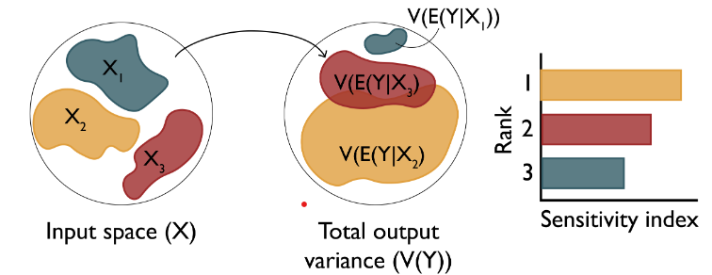
Research Objectives
Objective 1: Understand the key drivers of impact of malaria interventions in Ghana
Objective 3: Simulate the impact of malaria interventions in Ghana in order to support decisions for strategic planning
Objective 2: Develop a novel inference framework for calibrating the OpenMalaria model at a higher spatial resolution
Perform sensitivity analysis of coverage, halflife of efficacy and vector composition towards prevalence reduction and clinical cases averted (Forward propagation of uncertainty)
Results of the sensitivity analysis will help the NMEP to carefully choose intervention re-allocation if needed, during the midterm review
The sensitivity analysis will be integrated in the OpenMalaria workflow package, which will be publicly available
Source: Sensitivity Analysis: The Basics

Slide 7
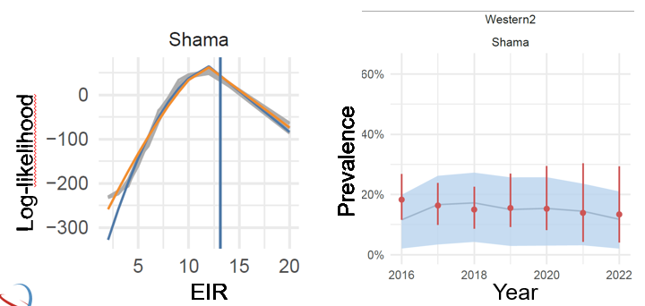
Research Objectives
Objective 1: Understand the key drivers of impact of interventions in Ghana
Objective 3: Simulate the impact of malaria interventions in Ghana in order to support decisions for strategic planning
Objective 2: Develop an efficient inference framework for calibrating the OpenMalaria model at a higher spatial resolution
Employ efficient sampling algorithms that have been proven to efficiently calibrate models with high-dimensional parameter spaces to design a framework to learn about the uncertainty of the parameters from district aggregated prevalence data from Ghana (inverse uncertainty quantification)
a fully implemented, tested, and documented sampling-based inference framework. This framework will be used to calibrate the OpenMalaria Ghana model
Source: MAP / OpenMalaria simulations

Slide 8
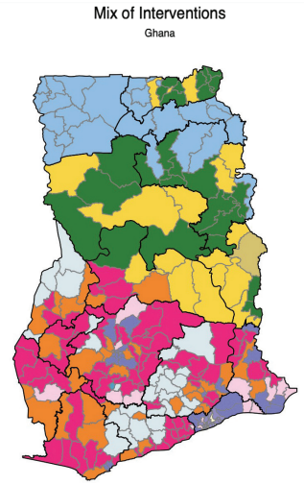
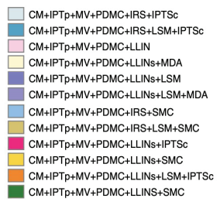
Research Objectives
Objective 1: Understand the key drivers of impact of interventions in Ghana
Objective 3: Simulate the impact of malaria interventions in Ghana in order to support decisions for strategic planning
Objective 2: Develop a novel inference framework for calibrating the OpenMalaria model at a higher spatial resolution
refine modeling scenarios for Ghana at the district level and define prioritization criteria for combinations of interventions
Source: Ghana NMESP 2024-2028.

Slide 9
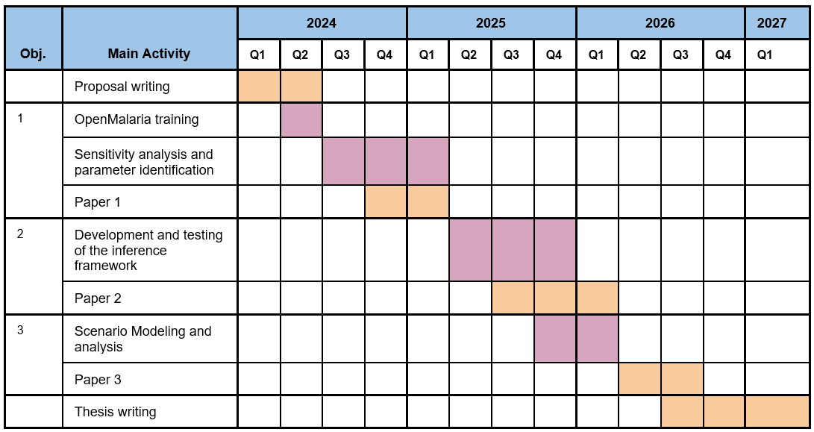
Time Plan

Slide 10
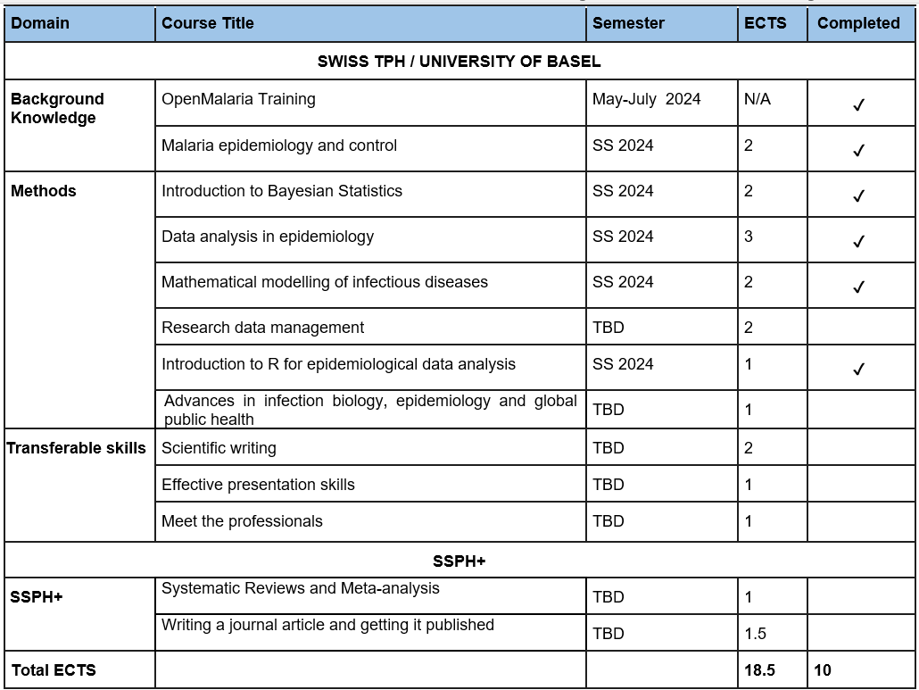
Planned Training During PhD

Slide 11
THANK YOU

